Slide 1

Introduction & Project Overview
www.shu-rouen-schools.com
Winter School 2024

Slide 2
Content
Welcome
Winter School Overview
Data Sources
https://www.shu-rouen-schools.com/

Slide 3

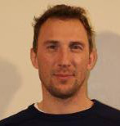
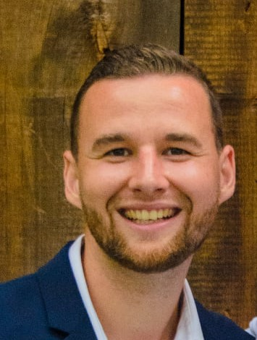

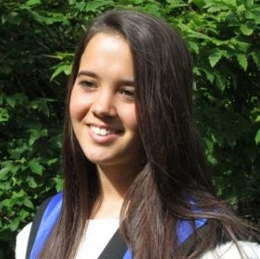
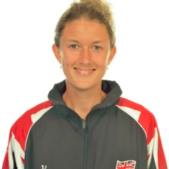
Staff and Speakers

Slide 4

Schedule

Slide 5
School Overview
Work in small teams to solve an applied sport science problems
Focus on Women's’ International Football Teams
Each group will adopt the role of the coaching and sport science team for a Paris 2024 woman's team

Slide 6

Scenario: Paris 2024
France
Spain
Netherlands
England
Denmark
Germany

Slide 7






Scenario: Paris 2024-First Group Game
France
VS
Spain
Netherlands
VS
England
Germany
VS
Denmark

Slide 8
Task 1: Preparing the Team for Set-Pieces
The head coach wants a plan on how best to prepare the team for set pieces:
Throw-Ins
Corners
Penalty Kicks
Propose an intervention/training session to implement these set piece strategies
Intervention should be informed by a guiding theoretical framework and research evidence base

Slide 9
Task 2: Opposition Analysis
Identify a tactical/performance weaknesses in the opposition
Propose a game plan for your team to exploit these weaknesses
Suggest an intervention/training design to implement this plan

Slide 10
Project Milestones
1. Team formation and task planning
2. Find research and decide on your guiding theoretical framework
3. Evaluate data sources to guide your tasks
4. Video/Data processing and analysis to demonstrate the strategies/problems
5. Design the proposed intervention/training sessions
6. Create a presentation ready for Friday afternoon to explain your work and performance preparation plans

Slide 11
Groups and Teams
France | Spain | Netherlands | England | Germany | Denmark
Hugo Gillier | Samuel Jagoury | Luca Lefevre | LucasLe Grand | Rafael Milla | Nicolas Rihouey
Corto Aslangul | Julian Bucher | Bastien Coeuret | Maxime David | Samuel Dubus | Maxime Horcholle
Alexis Fontaine | Manel Benkaci (remote) | MorvanLe Brun | Victor Lecerf | Teo Lepine | Oussama Boulahrouz (remote)
Tanakorn Cheeptumrong | Ade Oke | Arzu Bhalala | Sam Piper | Cihan Aydin | Akruti Pandoria
Kyle Ward | Alfie Jackson | Phoebe Ng | Hafiza Shafiq | Leandra Fernandes | Salahudin Salahu-Din
 | Mahnoor Malik

Slide 12

Get to know your groups
Introduce yourself and short background
Your main discipline area (e.g., Psychology, S&C, Performance Analysis….)
Sport or exercise you like to play/watch
SHU Student: Best/iconic UK food the Rouen students should try
Rouen students: Food you would like to try while in the UK
Any “fun” facts about yourself you want to share with the group

Slide 13



Data Sources

Slide 14
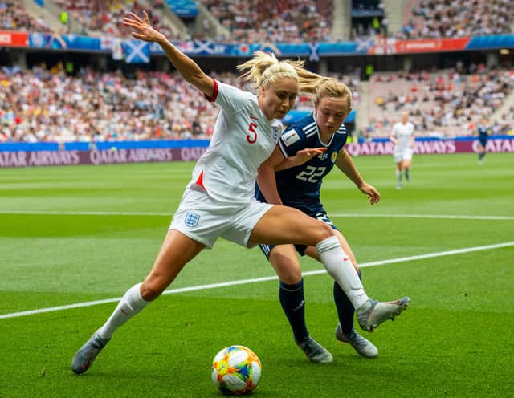
Match Footage
Full Matches
Pre-Clipped Footage
Ask Joe for specific requests

Slide 15

Code/Tag Data
Pen and Paper, Excel, Nacsport, Dartfish

Slide 16
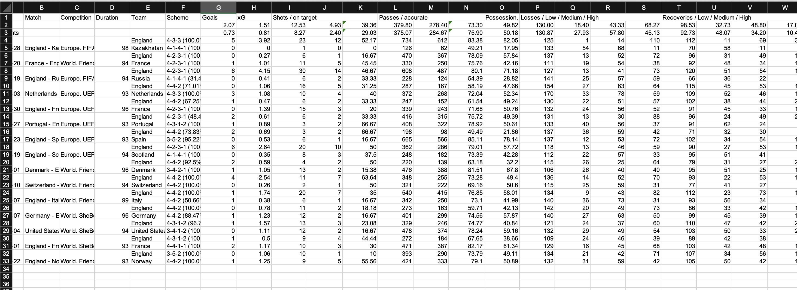
Pre-Tagged Summary Data

Slide 17
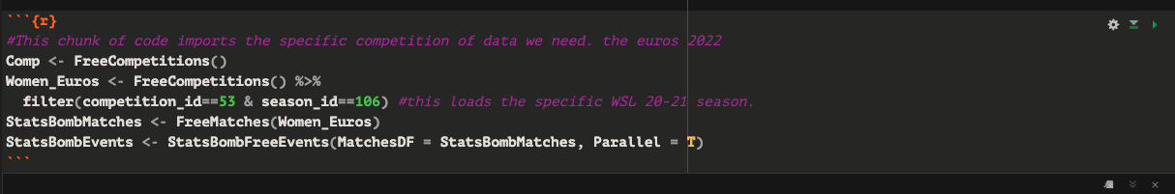
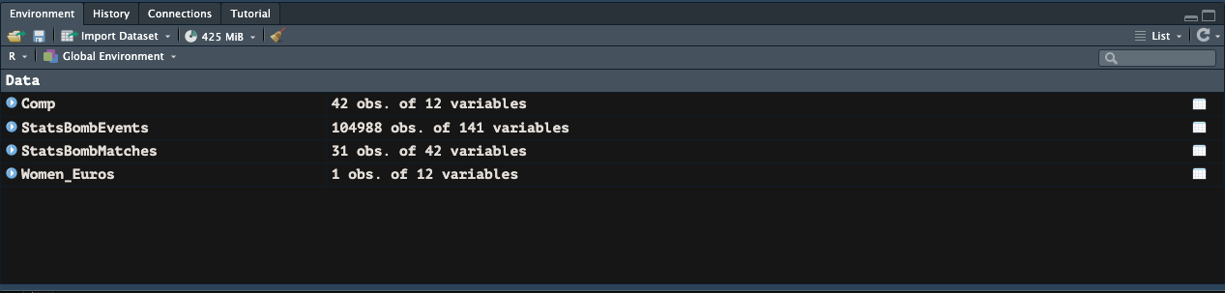
Pre-coded event by event data

Slide 18
Is having more data better?
http://www1.skysports.com/watch/video/sports/rugby-union/9756589/sports-science-in-rugby-union
What's and Wherefore’s
Data interpretation is critical
Coaches running the data, not the data running the coaches

Slide 19

Accessing Data for the week
https://drive.google.com/drive/folders/1dIxO9d66P6NiXGizZ6e5vuE1KJcKffkw?usp=share_link

Slide 20
Which data to use?
Time is short, like in professional sport
Use the skillset of your group
Plan and distributed the work
Use the staff for advice to help if you are unsure
You need to be ready to present on Friday afternoon

Slide 21
Friday Presentation
20 minutes maximum per group
Presentation guide here: https://www.shu-rouen-schools.com/slides/
Each group member should speak at least once during the presentation
Powerpoint slides can be used, but other methods of presentation style are also ok

Slide 22
Todays Tasks
1. Decide on the roles of each group member
2. Map out which areas you want to start investigating
3. Define the area/s of interest you will investigate
4. Start to examine the data sources

